Slide 1
The “Spark of Life”: Electrical Basis of the Action Potential, a Vital Signal of Nerve, Muscle and Endocrine Gland* Cells….. Giving Rise to Perhaps the Most Important Electrical Circuit You Will Ever Have To Know
IB Physics - 4
Spring 2019
Stan Misler
<latrotox@gmail.com>
*Cells that produce messengers (hormones) that travel through blood and act on target cells some distance away.

Slide 2
Doing science is a personal adventure “Turn on” in 1969 by a $2.74 paperback

Slide 3
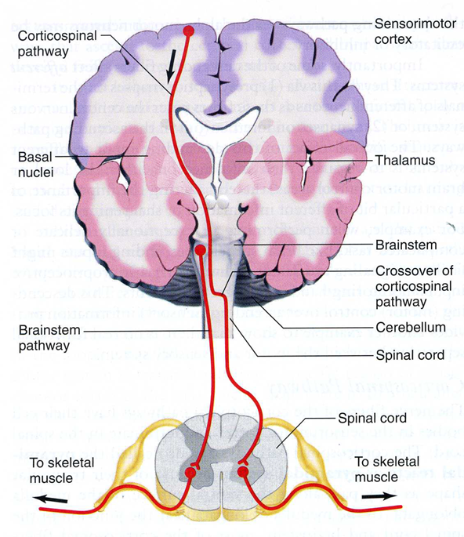
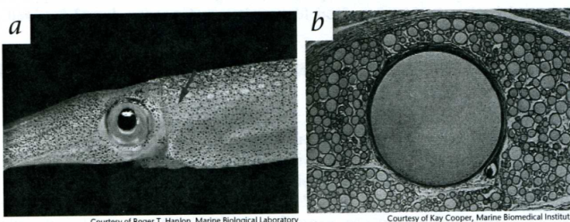
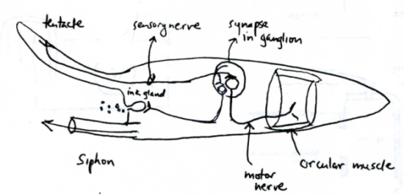
1. Introduction
a. The action potential (AP) is the basis for function of the nervous system. It is a propagating electrical wave, or impulse, of excitation nerve lasting ~ 1 ms and traveling at a velocity up to 1 meter per s. It enables (i) rapid communication between nerve cells; (ii) contraction of heart and skeletal muscle cells; and (iii) hormone release from endocrine cells. It is the basis for a simple behavior such as the knee jerk reflex the doctor tests, where an impulse set up at the tendon travels up sensory nerve fibers to the spinal cord and then back down motor fibers of the nerve to excite a muscle, which then contracts to give the visible knee jerk. It is also the basis for complex brain behavior such as thought
b. In a squid, an entire escape reflex behavior is based on a single AP traveling down a sensory nerve from the disturbed tentacle, via connection within a ganglion, triggering excitation of motor nerve. This contracts (i) the circular muscle of the tail forcing water through the siphon, resulting in backward jet propulsion of the squid and (ii) contraction of ink gland of the head thereby muddying the water with ink. Thus a squid not only moves far from a “threat”, it prevents the “threat” from seeing where the squid has gone and pursuing it.

Slide 4
c. Compared with (i) a velocity of 300,000,000 meters per second for an electromagnetic wave in a transatlantic cable or for light in air; (ii) a velocity of 1500 meters per second for speed of sound in water; or (iii) a velocity of 0.5 m/s for blood traveling down an artery, the nerve impulse velocity of ~ 50 m/s, suggests that the AP traveling down a nerve fiber is distinct from an electromagnetic or sound wave or, for that matter, a fluid wave.
d. As an identifying feature, the AP is abolished when a dissected nerve fiber is removed from a bath of dilute salt water (such as blood plasma or sea water) and is immersed in a bath of sucrose (a disaccharide or 2 sugar molecule). If the external bath remains sea water but the interior cytoplasm (gooh) is replaced with sucrose, AP once again is blocked. This suggests that the presence of external and internal ions, and perhaps their exchange across the nerve cell membrane, is needed for the impulse.

Slide 5
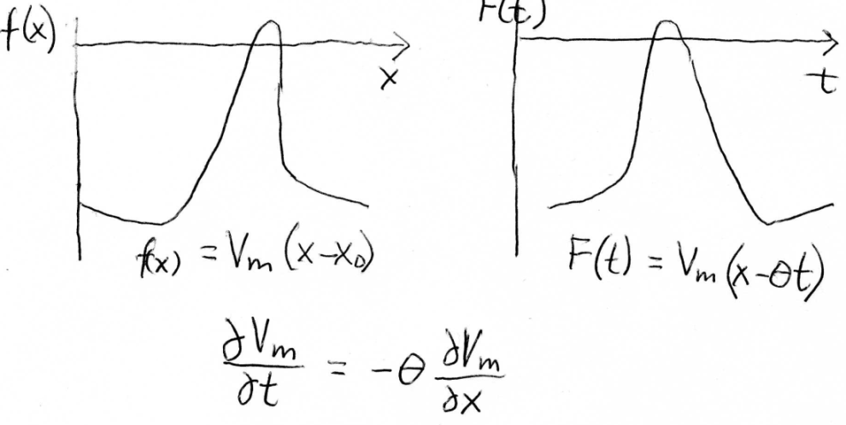
2. Recall the essential property of a propagating wave

Slide 6
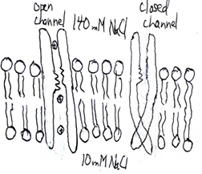
3. Recall that the cell has a plasma membrane.
The plasma membrane surrounding a cell consists of a phospholipid bilayer, which does not accommodate water and ions in its center, and proteins. (i) Globular proteins are embedded in one or the other sides of the bilayer. (ii) Transmembrane proteins span the width of the membrane; some have pores down the middle that are large enough to pass cations, anions or even water. Such transporters are called channels. The plasma membrane separates a solution of high [NaCl] on the outside from a high [KA] solution on the inside where A represents many organic anions that contribute to cell metabolism.
In electrical terms, we’d expect the lipid bilayer to act like parallel plate capacitor (Cm) separating charge, located in parallel with the channels acting like resistors (Rm), or more optimistically conductors (Gm) (where Gm = 1/Rm) allowing flow of charge (ions) at appropriate times. Various stimuli can switch channel from closed <-> open (change in voltage, membrane stretch, or a chemical applied to outside or inside surface of the cell

Slide 7
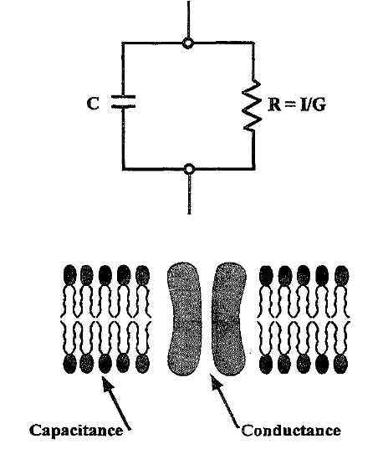
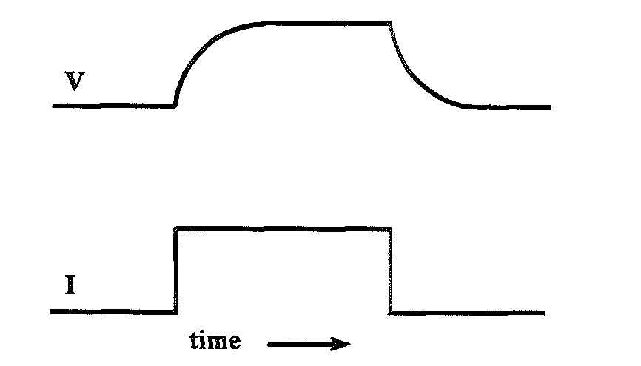
4. Demonstrating the validity of the proposed
equivalent circuit of the cell’s plasma membrane
Voltage responses of patch of plasma membrane to square pulse of current
Current response of patch of plasma membrane to square pulse of voltage
Current clamp
Voltage clamp

Slide 8
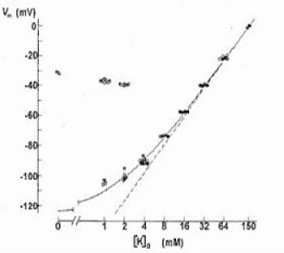
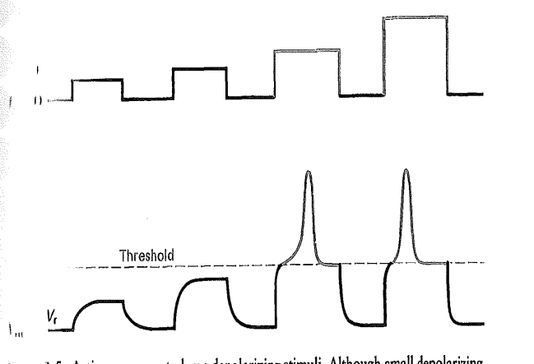
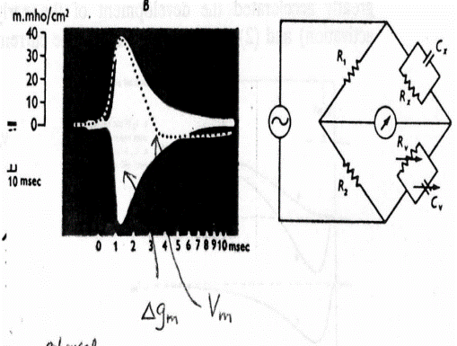
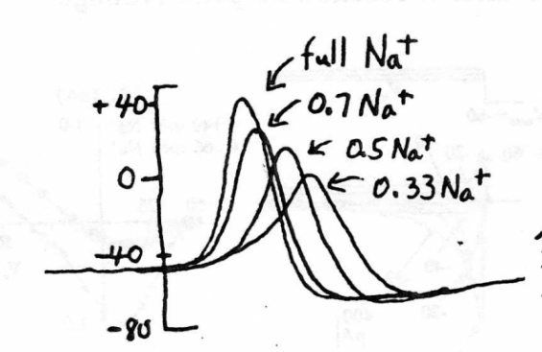
5. Expanding the equivalent circuit
Assuming now that the cell is a sphere whose plasma membrane separates a bath solution of 135 mM NaCl + 5 mM KCl and an internal solution of 10 mM NaCl + 130 mM KCl, the inside of the sphere is -70 mV (outside solution = ground), the resting potential. Imposing a pulse of current bringing the membrane voltage to -40 mV, causes a spike of voltage, to rise to an overshoot potential of +40 mV. The resting potential becomes less negative as the external [KCl] is increased, while the overshoot potential becomes less positive as the external [NaCl] is decreased. At the overshoot potential, Cm is unchanged while Gm is increased 10 fold as measured by a Wheatstone bridge. What equivalent circuit might you suggest now?
Each parallel resistor is in series with a battery, giving rise to current generator elements
Input current pulse
Output voltage

Slide 9
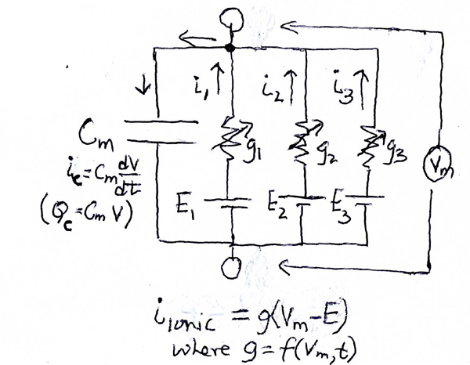
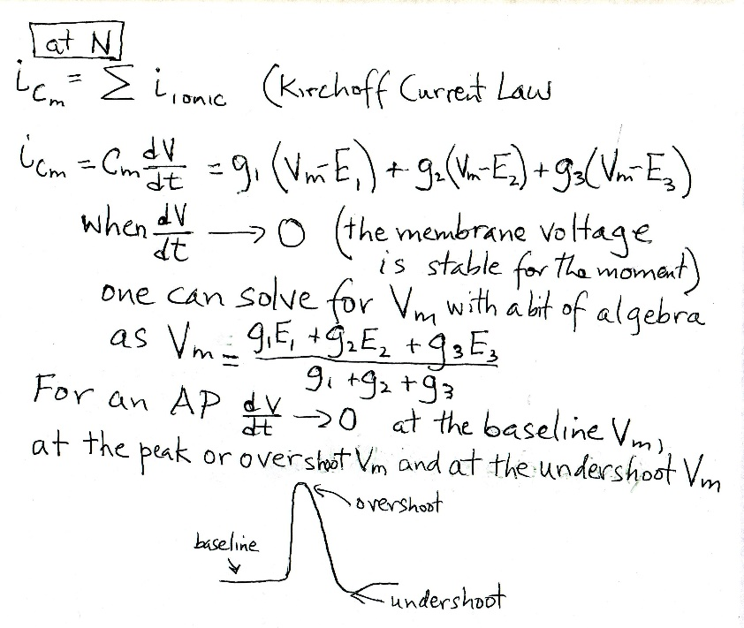
6. Analysis of the equivalent circuit representing the action potential
Kirchoff’s current law
states that at any node in a
circuit the sum of the current
entering the node equals the
sum of the current leaving it
(a law of conservation of charge).
At the node marked N,
the sum of all of the ionic currents, namely i1 + i2 + i3,
equals the current charging the capacitor, namely iCm
The current flow through each ionic current generator pathway will be the driving force = the difference between the voltage of each battery and the overall voltage across the membrane, Vm (a weighted sum of the batteries), multiplied by the conductance (g) of each of the i th pathway or
Iionic = gi (Vm – Ei)
In the axon there is a separate pathway for flow of Na, K and “leak” ions (say through a small tear in the membrane)
N

Slide 10
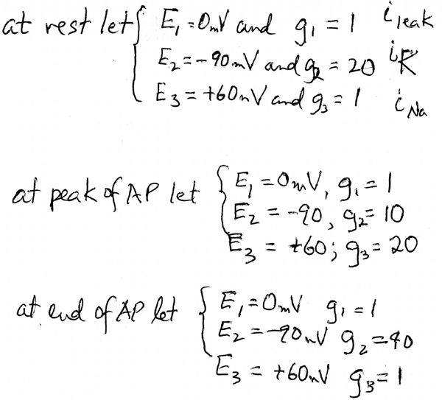
7. So we can say that we have dueling ionic conductances underlying the AP. These gs are affected by a change in Vm, caused by axon stimulation by a externally applied voltage, as well as by time elapsed after axon stimulation Let’s calculate Vm under each condition?
Take home message: The more channels of a particular type that are open, the closer the overall membrane potential (Vm) gets to the battery potential (Ei) of that type of channel

Slide 11
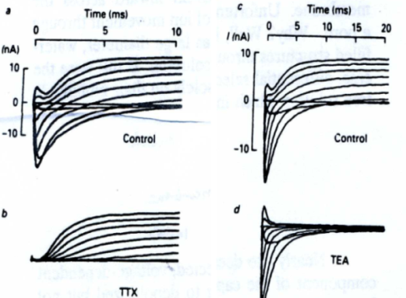
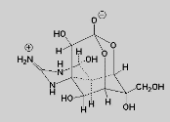
8. The voltage clamp technique allows separation of the currents underlying the AP
1. Separation of Voltage dependent Currents (Na & K):
Depolarization from near rest (-65 mV) to -9 mV gives rise to a very brief spike of outward current (capacitative current over in 20 us, not shown) followed by a complex set of ionic currents. In physiological external solutions an early inward current is followed by more continuous outward current (A). Removing most of [Na]o leaves only an outward current (B). The difference current (C) reveals the time course of the inward Na current, which rapidly activates and then inactivates.
2. Pharmacological separation of Na and K currents.
Tetrodotoxin, from the puffer fish, saxotoxin from red tide dinoflagellates, and the local anesthetic lidocaine are all specific blockers of INa. Tetraethylammonium, and dendrotoxin, from the green mamba snake, are specific blockers of IK. This confirms that INa and IK flow through biochemically distinct pathways rather than a single pathway changing its selectivity midstream.

Slide 12
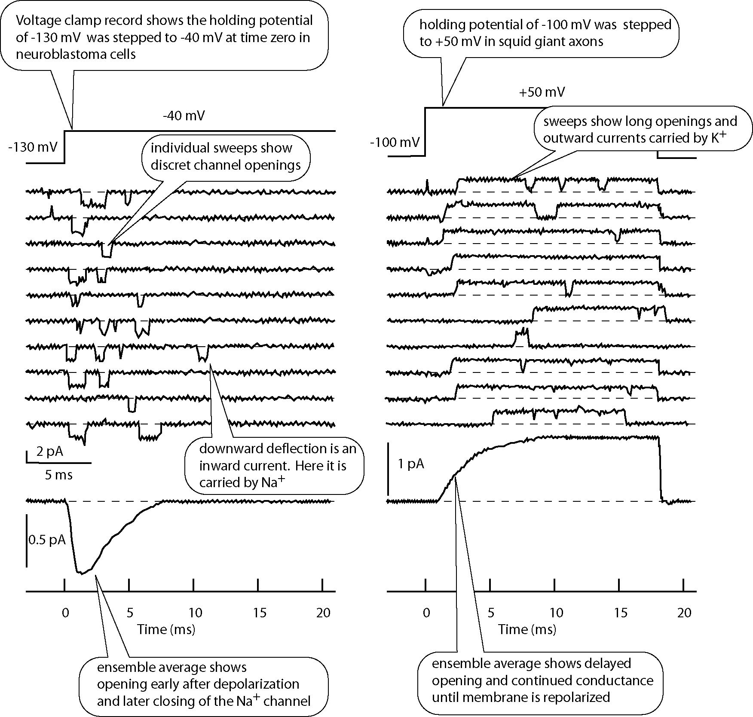
9. The patch clamp technique (voltage clamping only a small patch of cell membrane) allows measurement of thin voltage dependent Na and K currents flowing through single ion channels (single protein molecules with a hole down the middle)
Note: INas “activate” (open) within 1 ms of reducing Vm and then almost complete inactivation after 5 ms.
In contrast, it takes at least 5 ms for IK to “activate) and then reach a steady state. Inactivation of IK occurs over several seconds.

Slide 13
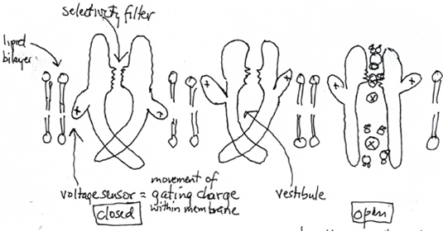
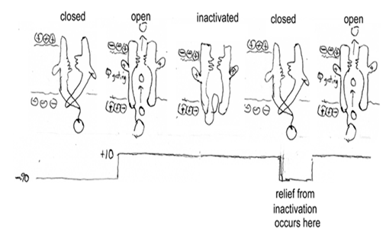
10. A cartoon of voltage dependent gating of a channel
On changing transmembrane voltage from -70 mV inside to +10 mV inside, charged voltage sensor wings of the channel move within the plane of the membrane. This opens the tail of channel allowing ions to flow into its pore and then out through the selectivity filter (left panel). In some types of channels this followed by slower movement of ball-on-chain into channel to occlude pore from its cytoplasmic side (right panel). However on return of Vm to -70 mV inside the ball-on-chain is swept out of the channel before the channel pore closes. The channel is then ready to reopen when Vm is returned to +10 mv

Slide 14
11. The Nernst equation and the battery for the channel
The EMF or battery voltage of each type of channel is an equilibrium potential or the potential at which the flow of current through the channel reverses direction (inward to outward or outward to inward).

Slide 15
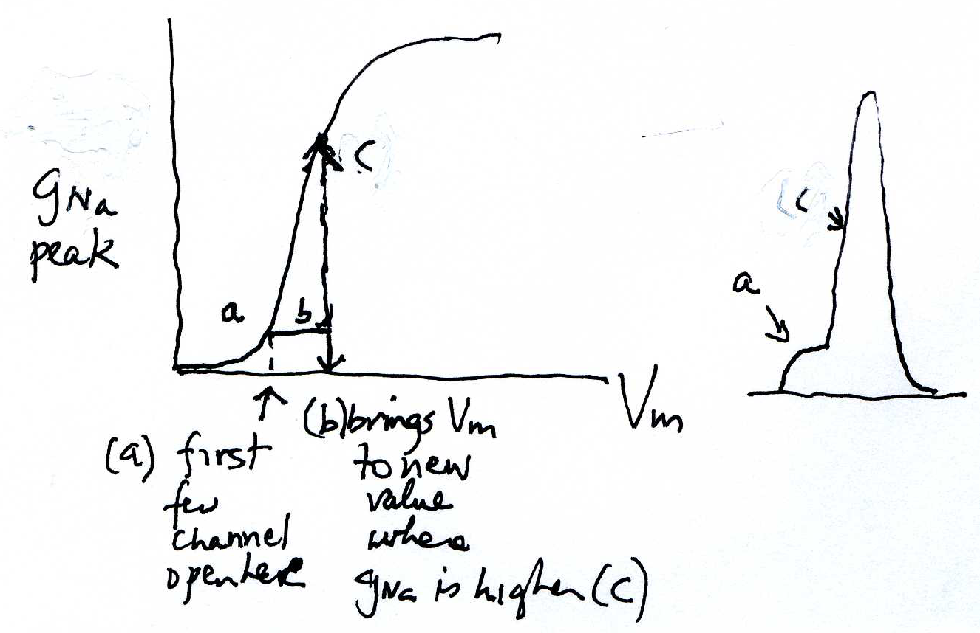
12. What is a voltage threshold?
In the AP there is a regenerative effect: Opening the first few voltage dependent Na channels brings Vm to a voltage where more voltage dependent Na channels can open. This is repeated several times in a ms and gives rise to the rapid change in membrane voltage (~200mV/ ms).

Slide 16
13. The process of “evoking” an AP is a process of analog to digital conversion
Analog process = continuous depolarization
Digital process =
a pulse code
Increased depolarization -> higher frequency of APs

Slide 17
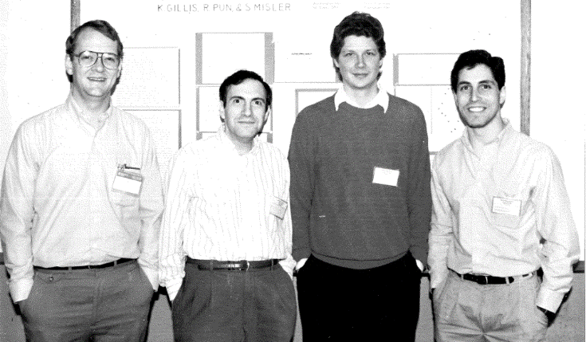
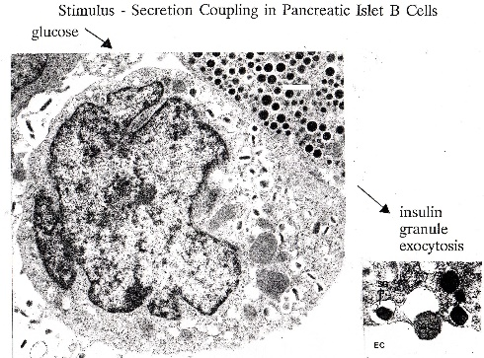
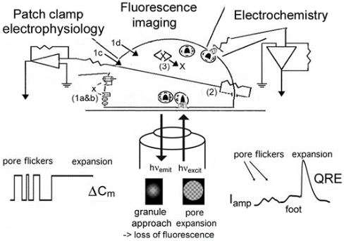
So what resulted from that “turn on” in 1969: A career of 40 years of laboratory study that was lots of fun with students and friends
Study of how magnesium blocks signal transmission from nerve to muscle.
Study of ion channels underlying glucose-triggered action potential and their relation to insulin secretion by the pancreas for the control of blood sugar
Study of mechanism of action of toxin from black widow spider that “paralyzes” cells (it makes ion channels allowing cell to be flooded with Ca first enhancing and then blocking AP in excitable cells)
Study of ion channels opened by membrane stretch or cell swelling that helps allow cells to regain shape rather than burst.
Study of new techniques for measuring chemical release from voltage clamped cells

